Slide 1

CAPSTONE PRESENTATION
CSA0712:COMPUTER NETWORKS
DESIGN AND DEVELOPING THE SECURE INTRUSION DETECTION SYSTEM DOOR LOCK SYSTEM USING RFID OVER NETWORKS
GUIDED BY
Dr.S.Salini
Assistant Professor
PRESENTED BY
P.KRISHNAPRIYA(192511279)
C.SRAVATHI(192525463)
A.G.KESHIKA LAKSHMI(192521056)
DEPT:CSE&AIML&IT

Slide 2


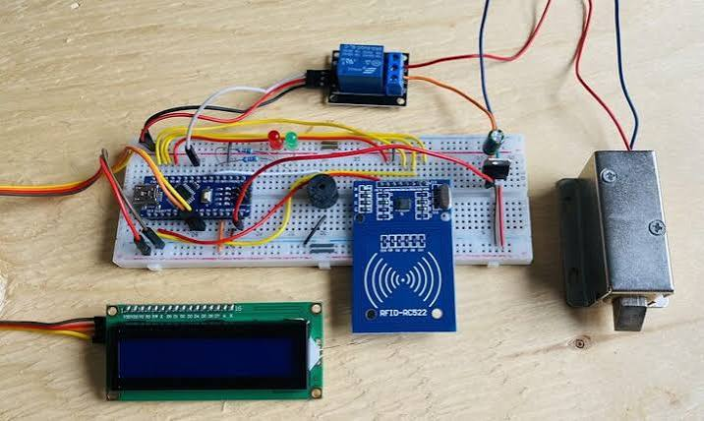
INTRODUCTION
RFID (Radio Frequency Identification) is used to provide secure and contactless access using authorized RFID cards or tags.
The system combines an RFID door lock with an intrusion detection mechanism to prevent unauthorized access.
It is connected over a network, allowing real-time monitoring and remote management of the door lock.
The system records every access attempt and sends alerts when an invalid RFID card or intrusion is detected.
This solution improves security, reliability, and efficiency, making it suitable for homes, offices, laboratories, and other restricted areas.

Slide 3
OBJECTIVE
To develop a secure RFID-based door lock system that allows access only to authorized users.
To detect and prevent unauthorized access by integrating an intrusion detection mechanism with the door lock.
To enable network-based monitoring and control for real-time alerts, access logging, and remote management.

Slide 4
Literature Review
S.No. | Author | Work | Problem Statement | Solution
1 | S. Batra & A. Pattnaik | RFID Smart Card Door Lock (2021) | Traditional door locks may not provide secure and convenient access control. | Proposed an RFID smart card-based door lock for secure and contactless authentication.
2 | Shubham Soni, Rajni Soni & Akhilesh A. Waoo | RFID-Based Digital Door Locking System (2021) | Conventional locking methods can have limitations in controlling access to restricted areas. | Developed an RFID-based digital door-locking system that allows access to authorized users.
3 | T. Nasution, Herwin & Andesa K | RFID and Voice Recognition Based Dual Security System (2024) | A single authentication method may not provide sufficient security for sensitive areas. | Combined RFID and voice recognition to provide dual-layer authentication.
4 | Yudi Wijanarko, Niksen Alfarizal & Muhammad Regi Pratama | RFID RC522 and IoT-Based Automatic Door Security System (2025) | Basic RFID systems may have limited monitoring and connectivity capabilities. | Integrated RFID RC522 with IoT for automatic door security and monitoring.

Slide 5

PROBLEM STATEMENT
Traditional door lock systems are less secure and can be opened using duplicated or stolen keys.
They do not provide real-time monitoring or remote access control.
Unauthorized access attempts are not detected immediately, increasing security risks.
There is a need for a system that authenticates users using RFID and detects intrusions.
A network-based RFID door lock system can improve security by providing access control, intrusion detection, and instant alerts.

Slide 6


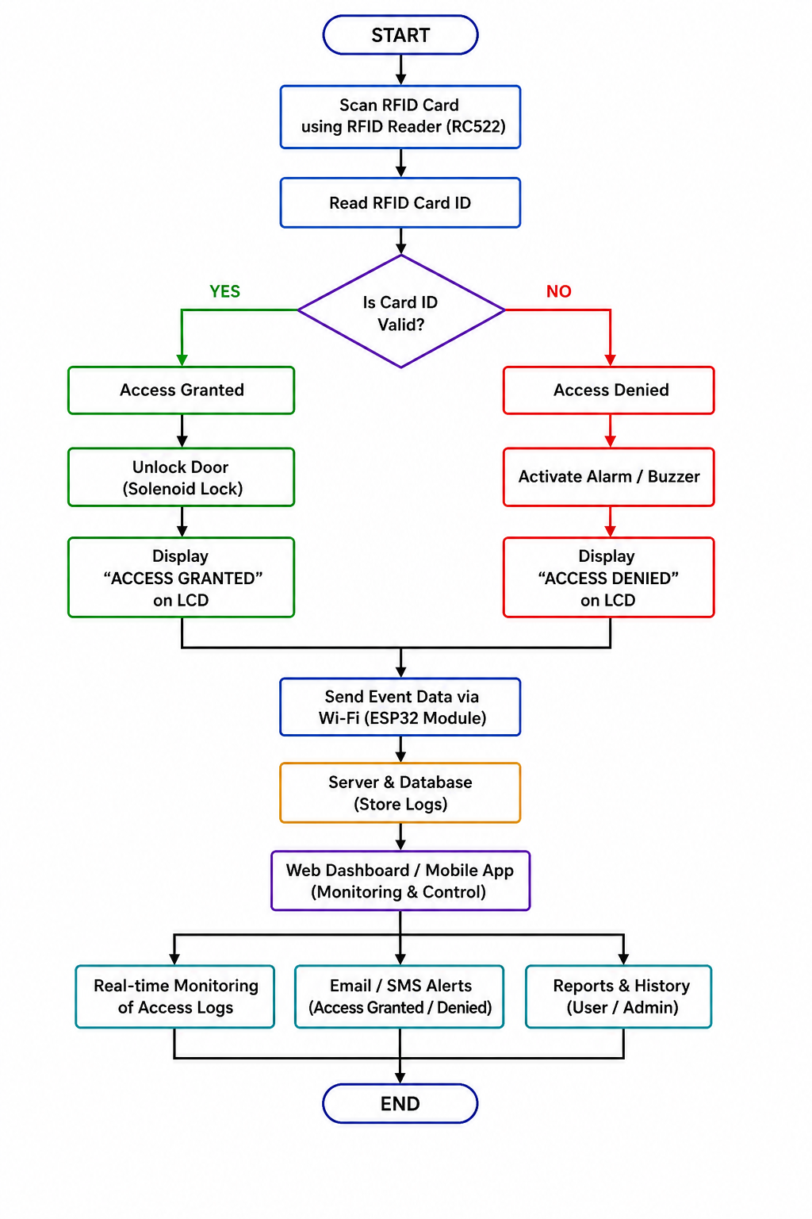
ARCHITECTURE DIAGRAM

Slide 7
PROPOSED SYSTEM
The proposed system uses RFID (Radio Frequency Identification) technology to provide secure and contactless access to authorized users.
Each authorized user is assigned a unique RFID card, and only registered cards can unlock the door.
The system verifies the RFID card by comparing it with the stored database before granting access.
If an unauthorized RFID card is detected, the system immediately denies access and activates the intrusion detection mechanism.
Real-time alerts are sent to the administrator over the network to notify them of unauthorized access attempts.
The system maintains a digital log of all entry and exit activities, including date, time, and user details, for monitoring and future analysis.
By integrating RFID authentication, automated door locking, network communication, and intrusion detection, the proposed system provides a secure, reliable, and cost-effective solution for homes, offices, laboratories, and other restricted areas.

Slide 8
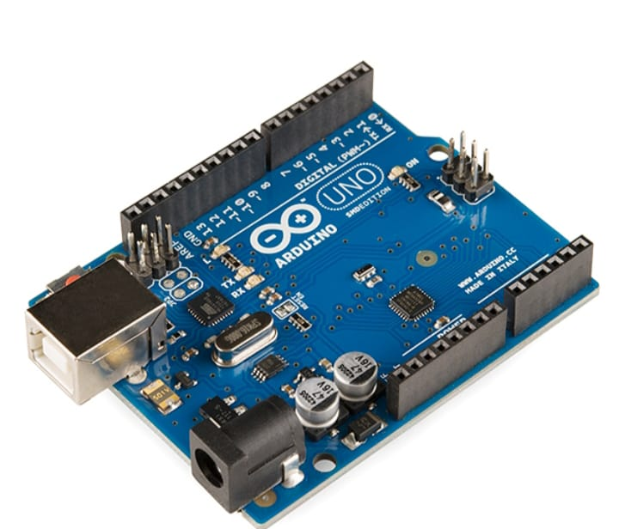
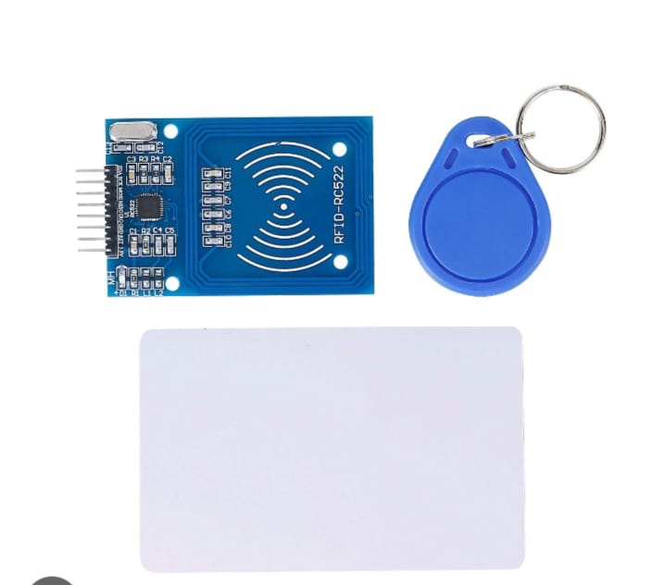
COMPONENTS USED
RFID Tag/Card : Contains a unique identification number (UID).
RFID Reader (RC522 or similar) : Reads the UID from the RFID tag and sends it to Arduino.
Arduino Board : Acts as the brain of the system — processes RFID data, checks authorization, and controls outputs

Slide 9
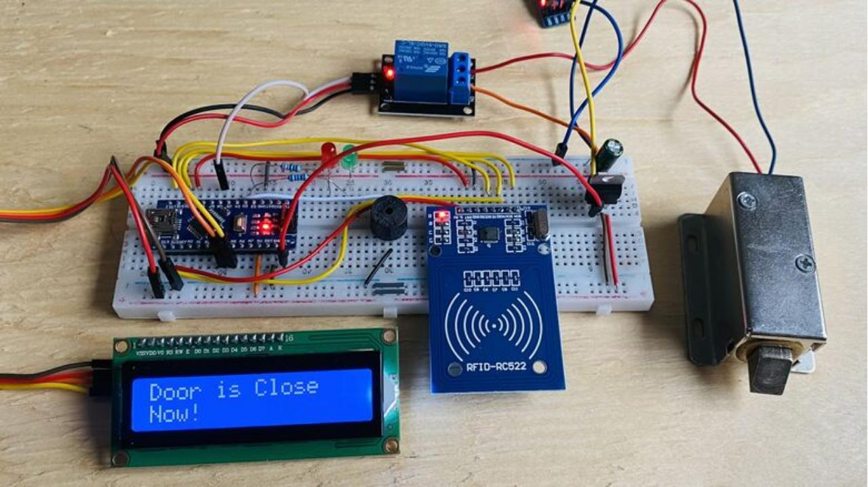
MODULE : 1
RFID-Based Secure Door Access & Intrusion Detection
RFID card scanning using RC522 RFID reader
Read and verify RFID card ID
Valid card → Access Granted
Invalid card → Access Denied
Activate buzzer/alarm for unauthorized access
Control the solenoid door lock
Display access status on LCD
Detect repeated unauthorized access attempts
Main components:
RFID RC522 → ESP32 → LCD → Solenoid Lock → Buzzer

Slide 10
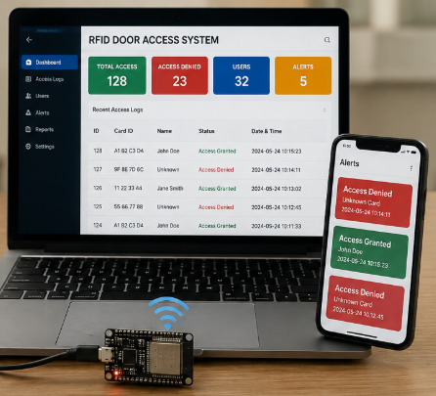
MODULE : 2
Network-Based Monitoring & Security Management
ESP32 Wi-Fi communication
Send access/intrusion events to the server
Store access logs in a database
Web dashboard/mobile interface for monitoring
Real-time display of authorized and unauthorized attempts
Email/SMS alerts for intrusion
View access history and generate reports
Main components:
ESP32 Wi-Fi → Server/Database → Web Dashboard/Mobile App → Alerts & Reports

Slide 11
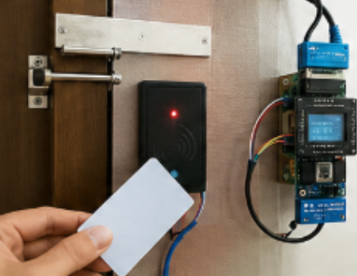
MODULE : 3
PERFORMANCES AND ANALYSIS
Authentication Accuracy – Accurately identifies authorized and unauthorized RFID cards.
Response Time – Provides quick authentication and door-lock operation after RFID scanning.
Intrusion Detection – Detects unauthorized access attempts and prevents entry.
Network Performance – Transmits access and intrusion information reliably over the network.
Door Lock Reliability – Unlocks for authorized users and remains locked for unauthorized users.
System Security & Scalability – Provides secure access control and can be extended to multiple doors and users.

Slide 12
TOOLS AND TECHNIQUES USED
TOOLS USED: | TECHNIQUES USED:
ESP32 Microcontroller | RFID-Based User Authentication
RFID Reader (RC522) | Real-Time Intrusion Detection
RFID Cards/Tags | Network Communication (Wi-Fi)
Solenoid Door Lock | Automated Door Lock Control
Magnetic Door Sensor | Access Control and User Verification
LED Lights | Real-Time Alert Notification
Arduino IDE | Event Logging and Monitoring
Web Server | Remote Access Management

Slide 13
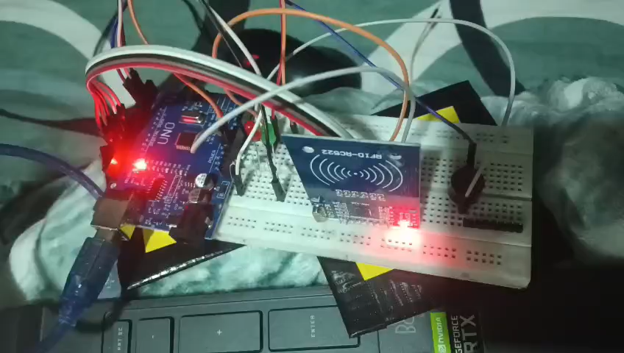
HARDWARE MODEL DEMONSTRATION

Slide 14
ENGINEERING STANDARDS
ISO/IEC 14443 – Standard for RFID proximity cards and readers used for secure user authentication.
ISO/IEC 18000 – Defines RFID air-interface standards for communication between RFID tags and readers.
IEEE 802.11 – Standard for wireless network communication when Wi-Fi is used to transmit access and intrusion information.
IEC 62443 – Industrial cybersecurity standard used as a reference for protecting network-connected control systems against unauthorized access and cyber threats.
ISO/IEC 27001 – Information security standard that provides guidelines for protecting authentication data, access records, and network information.
IEEE 802.3 – Ethernet networking standard applicable when the RFID door-lock system communicates through a wired LAN.
IEC 60529 (IP Code) – Can be considered for selecting protective enclosures for RFID readers, controllers, and electronic components used in physical environments.

Slide 15
ADVANTAGES AND LIMITATIONS
ADVANTAGES | LIMITATIONS
Provides secure and automated door access using RFID authentication. | The system may be affected by network failure or connectivity issues.
Detects unauthorized entry attempts and improves intrusion monitoring. | RFID cards can be lost, stolen, or cloned.
Enables network-based monitoring and remote security control. | Requires proper hardware installation and regular maintenance.
Reduces the need for manual security management and improves convenience. | Initial implementation may involve additional setup and infrastructure costs

Slide 16
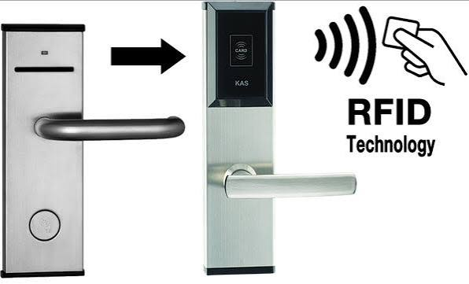
FUTURE SCOPE
Mobile-Based Control – Develop a mobile application for remote door access and monitoring.
Biometric Integration – Combine RFID with fingerprint or face recognition for stronger authentication.
Cloud Data Storage – Store access records and security data securely on cloud platforms.
AI-Based Detection – Use Artificial Intelligence to identify suspicious activities and intrusion patterns.
IoT Integration – Connect the system with smart home and IoT devices for automated security control.
Real-Time Alert System – Add instant notifications through SMS, email, or mobile alerts during unauthorized access attempts.

Slide 17
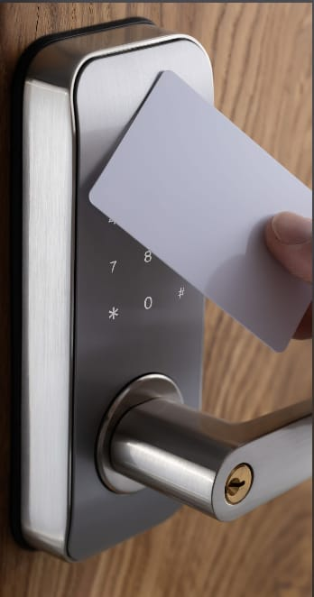
CONCLUSION
The Secure Intrusion Detection Door Lock System using RFID over Networks provides a secure and automated method for controlling access to protected areas.
RFID authentication ensures that only authorized users can unlock the door, helping to reduce unauthorized access.
The intrusion detection feature identifies suspicious entry attempts and supports immediate security alerts.
Network connectivity enables real-time monitoring and access record management, improving overall security control.
Overall, the system offers a reliable, efficient, and user-friendly security solution that can be further enhanced using IoT, biometrics, AI, and cloud technologies.

Slide 18
REFERENCES
S. Batra & A. Pattnaik, RFID Smart Card Door Lock, International Journal of Engineering Research & Technology (IJERT), **Vol. 10, Issue 11, Nov. 2021_.
Shubham Soni, Rajni Soni & Akhilesh A. Waoo, RFID-Based Digital Door Locking System, Indian Journal of Microprocessors and Microcontroller, **Vol. 1, No. 2, 2021_
T. Nasution, Herwin & Andesa K, RFID and Voice Recognition Based Dual Security System: A Robust Secured Control to Access Through Door Lock Operation, Journal of Research and Technology, **Vol. 10, No. 1, June 2024_.
Yudi Wijanarko, Niksen Alfarizal & Muhammad Regi Pratama, Implementation of an RFID RC522 and IoT-Based Automatic Door Security System, Indonesian Journal of Artificial Intelligence and Data Mining, **Vol. 8, No. 2, 2025_.

Slide 19


